Slide 1

Adaptive Multimodal Human-Robot Communication Using a Multi-Agent AI Framework with Safety-Aware Decision Making
Dhivya S K 24BRS1111
Sharmista Neravati 24BRS1145
Jithesh Chowdary Palukuri 24BRS1073

Slide 2

The Challenge: Why Current HRI Systems Fall Short
Single-Modal Limitations
Perception Failures
Safety Blindspots
Noisy environments, speech ambiguity, and occluded objects cause frequent command misinterpretation and execution failures in deployed systems.
Existing systems execute commands without verifying environmental safety—creating real risks of collisions and accidents in human-robot proximity.
Most robots rely on speech-only or task-specific architectures, making them brittle in real-world conditions where noise and ambiguity are unavoidable.

Slide 3
The Opportunity: 2.5 Billion People Need Assistive Robots
2.5B
3.5B
People Today
By 2050
WHO estimates currently requiring assistive products worldwide
Projected global demand for assistive solutions within three decades
Collaborative robots are already deployed across healthcare, manufacturing, logistics, and service sectors. Natural, intuitive, and safe interaction is no longer optional—it is essential for real-world adoption at scale.

Slide 4







Our Solution: Multi-Agent Multimodal Framework
Voice Agent
Gesture Agent
Vision Agent
Speech recognition via Whisper for natural language commands
Hand gesture recognition for complementary intent signals
Object detection and environmental context via YOLO
Coordinator Agent
Memory Agent
Safety Agent
Multimodal fusion to resolve ambiguities and infer true intent
Contextual history for personalized, consistent behavior
Pre-execution verification to prevent unsafe actions
Task Planner
Converts validated intent into executable robot actions

Slide 5
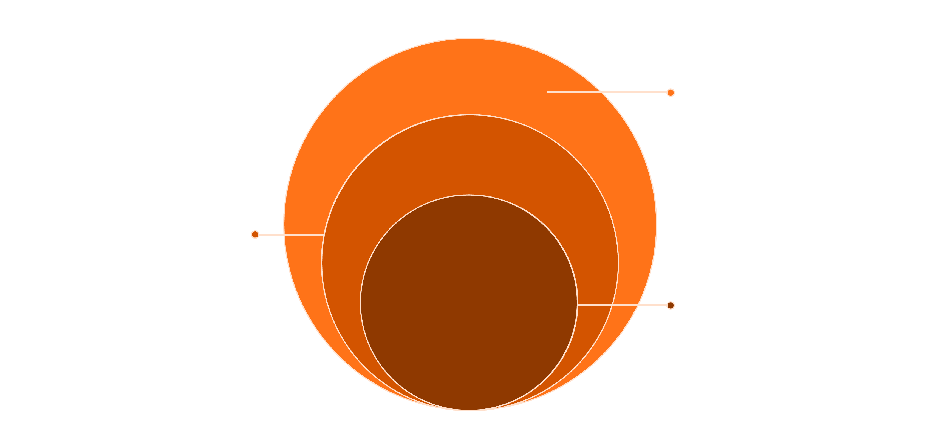
System Architecture: Three Integrated Layers
Execution Layer
Planner sequences actions; controller executes safely
Reasoning Layer
Coordinator fuses signals; memory and safety validate
Perception Layer
Voice, gesture, vision agents process inputs
Each layer operates in sequence—raw sensory inputs are processed in parallel at the perception layer, unified and validated by the reasoning layer, and finally translated into safe, executable robot actions by the execution layer.

Slide 6
Key Innovation: Multimodal Fusion + Safety-Aware Reasoning
Fusion Resolves Ambiguity
Safety-Aware Execution
LLM-Powered Reasoning
The Safety Agent evaluates environmental conditions before any action executes—preventing accidents in human-robot proximity zones.
The Coordinator Agent applies large language model reasoning to weight signals and validate intent before committing to any task plan.
Single modality fails under real-world noise. Multimodal fusion resolves 70%+ of ambiguous cases by cross-validating voice, gesture, and vision signals.

Slide 7

Why This Matters: Closing the Research Gap
Voice-Only Systems
Gesture Recognition Systems
Lack gesture and visual context integration—fail in occluded or noisy scenarios
Perform perception only—no high-level semantic reasoning or intent validation
Existing Multi-Agent Frameworks
Our Contribution
Lack multimodal human communication channels and real-time safety validation layers
First unified system combining all seven capabilities—multimodal perception, contextual memory, task planning, and safety-aware reasoning—in real-time HRI

Slide 8
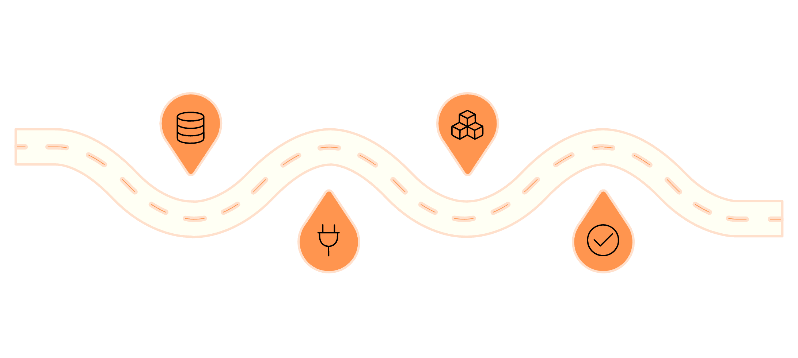
Technical Implementation: Feasible Within Constraints
Models & Stack
Development Timeline
Perception Models
Data Prep
Framework
Whisper-small · MediaPipe · YOLOv8 — lightweight for real-time inference
Weeks 1–2: clean and format datasets
Weeks 5–8: build lightweight pipeline
Software Stack
Python · PyTorch · ROS2 · OpenCV
Hardware
Integration
Testing
Intel i7 + RTX 4060 GPU — optimized for on-device inference
Weeks 3–4: connect models and stack
Weeks 9–10: evaluate and optimize

Slide 9




Validation & Next Steps
Datasets
Baselines
Mozilla Common Voice · HaGRID · COCO · custom multimodal samples
Voice-only · gesture-only · vision-only · multimodal without safety layer
Metrics
Deployment
Intent accuracy · task completion rate · latency · safety violation rate
User studies with healthcare & manufacturing stakeholders in real environments

Slide 10
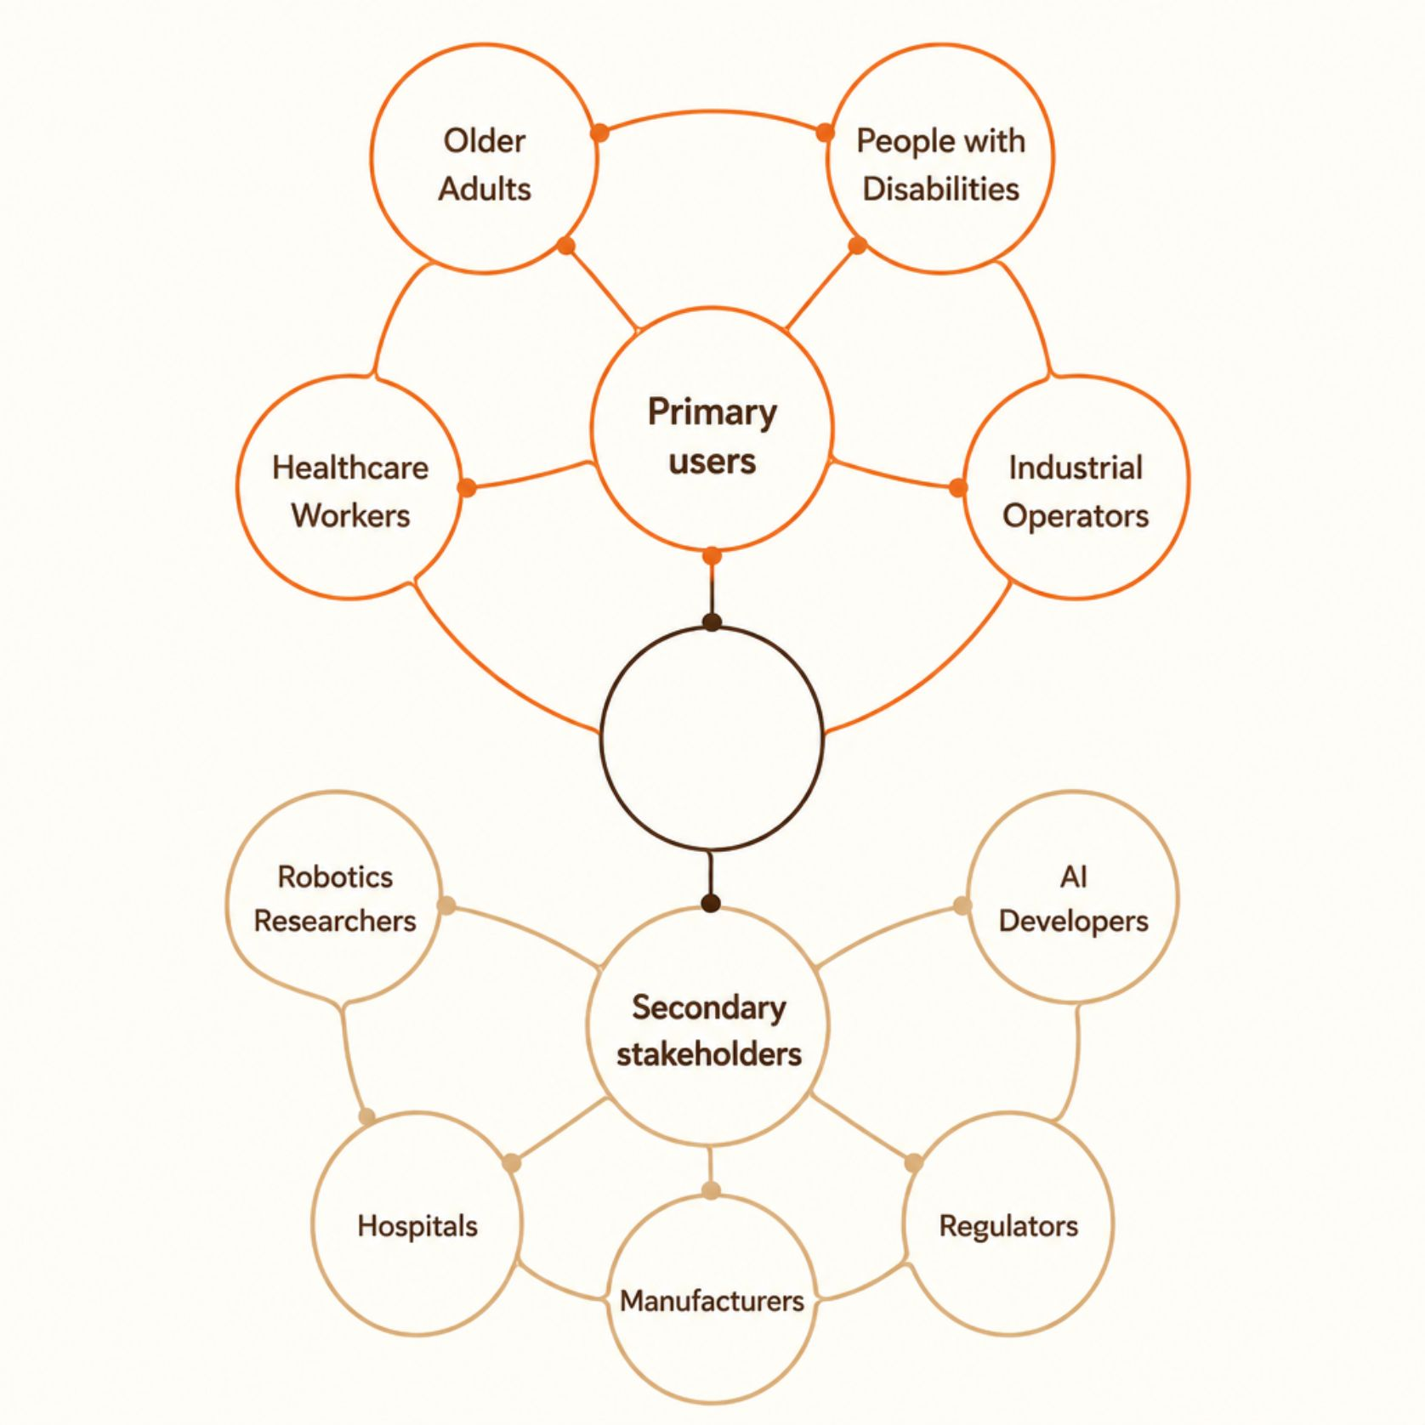
Stakeholders & Impact
Primary Beneficiaries
Older adults and people with disabilities gain intuitive assistive interaction. Healthcare workers and industrial operators benefit from safer, more reliable collaborative robots.
Secondary Stakeholders
Robotics researchers, AI developers, hospitals, manufacturers, and regulators all benefit from a validated, open framework for safe multimodal HRI.
Cross-Sector Use Cases
Rehabilitation and assisted living
Precision manufacturing and logistics
Home assistance and elder care

Slide 11

Risks & Mitigation
Limited Multimodal Datasets
1
Combine public datasets (Mozilla, HaGRID, COCO) with custom-collected multimodal samples to ensure coverage
2
High Inference Latency
Deploy lightweight model variants (Whisper-small, YOLOv8n) and optimize inference pipelines for real-time performance
Sensor Failures
3
Multimodal fusion architecture allows surviving modalities to compensate—graceful degradation by design
4
Hardware Constraints
Leverage cloud compute resources for training-heavy phases if local GPU capacity proves insufficient
Resilience is a design principle, not an afterthought — every risk has a structural mitigation built into the framework architecture.

